Slide 1
Scope and The Global Objects
The Var Keyword and Scope | Global variables and the global object
Notes:
Welcome to our lecture on scope of the variables in JavaScript and global objects. In this lecture we will go through the VAR keyword and the scope of the variables, and we will investigate global variables and global objects. Let’s start our lecture.

Slide 2
The Var Keyword
Variable Declaration: Variables can be declared using var or let. Example: var x = 6;.
Original Method: The var keyword was the original way to declare variables in JavaScript.
Modern Update: The let keyword was introduced in 2015 to provide improved scoping.
Notes:
Variables in JavaScript can be declared using var or let. The var keyword was the original method for variable declaration, allowing developers to assign values to variables, such as var x equals 6. However, in 2015, the let keyword was introduced to provide improved scoping and flexibility, making it a more robust option for variable declarations in modern JavaScript code.

Slide 3
Scope of the Variable
Scope: Scope defines where a variable can be accessed.
Local Scope: Variables declared inside a function are only accessible within that function.
Global Scope: Variables declared outside a function are accessible to all functions.
Notes:
Scope determines where a variable can be accessed in JavaScript. Variables declared inside a function have local scope, meaning they can only be used within that function. In contrast, variables declared outside any function have global scope, allowing them to be accessed by all functions in the program. Understanding scope is crucial for managing variable accessibility and avoiding conflicts.

Slide 4
Scope (Cont’)
Function Scope with var: Variables declared with var inside a function are accessible anywhere within that function.
Block Scope with let: Variables declared with let inside a function are accessible only within the enclosing {} block.
Notes:
In JavaScript, scope differs based on the variable declaration method. Variables declared with var have function scope, meaning they are accessible anywhere within the function where they are defined. Variables declared with let have block scope, meaning they are only accessible within the specific pair of curly braces where they are declared. This distinction is important for managing variable accessibility.

Slide 5
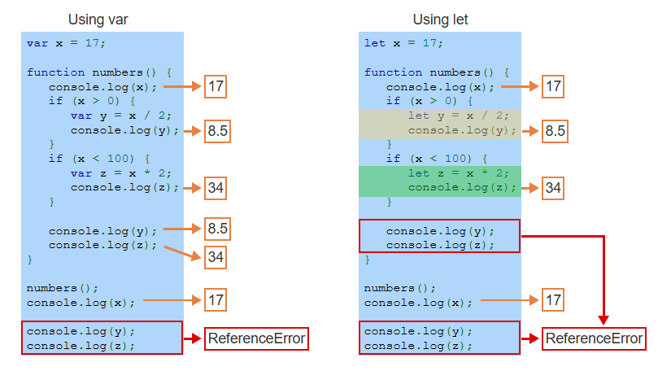
Example
Notes:
This example compares var and let. Using var, variables have function scope, so y and z are accessible throughout the function even outside their blocks. Using let, variables have block scope, so y and z are only accessible within their respective blocks. Outside those blocks, accessing y or z causes a Reference Error, showing how let restricts variable scope to improve control and avoid conflicts.

Slide 6
Global variables and the global object
Global Object: JavaScript creates a global object that stores global variables, functions, and properties.
Global Variables: In web browsers, global variables are assigned as properties of the window object (e.g., window.test).
Caution with Global: Global variables can overwrite existing window properties, potentially causing issues.
Example Issue: Assigning location = "Texas" overwrites window.location and causes the browser to try loading a non-existent URL.
Notes:
Now move on to global variables and objects. JavaScript creates a global object that stores global variables, functions, and properties. In web browsers, global variables become properties of the window object, such as window dot test. Be cautious with global variables, as they can overwrite existing window properties. For example, assigning location equals Texas overwrites window dot location, causing the browser to load an invalid URL.

Slide 7
Global variables and the global object
Three cases exist when assigning to a global variable X:
Declared with var: A property named "X" is added to the global object.
Declared with let: No property is added to the global object, but "X" is accessible globally.
Not Declared: "X" becomes a property of the global object, even if assigned inside a function.
Notes:
There are three cases for assigning a global variable X. When declared with var, a property named X is added to the global object. When declared with let, no property is added to the global object, but X is still globally accessible. If not declared with var or let, X automatically becomes a property of the global object, even if assigned within a function. This behavior can lead to unintended consequences.

Slide 8
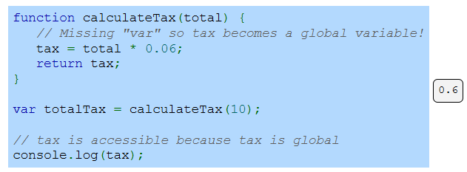
Example
Notes:
This example shows the impact of not declaring a variable with var, let, or const. In the calculate Tax function, the variable tax is not declared, so it automatically becomes a global variable. As a result, tax can be accessed outside the function, which may lead to unexpected behavior. To avoid this, always declare variables explicitly to ensure they are scoped correctly. Thanks for watching the lecture.

